Slide 1
Global COVID-19 Impact Dashboard
Historical analysis of confirmed cases, deaths, trends, and country-level impact Presented by: Goodness Festus

Slide 2
Dataset Overview
Dataset: Johns Hopkins CSSE COVID-19 Dataset Data used: Confirmed cases and deaths time-series files Period covered: January 2020 to March 2023 Tool used: Microsoft Power BI

Slide 3
Problem Statement
The project analyzes the global impact of COVID-19 by tracking confirmed cases, deaths, death rate, and country-level spread over time.

Slide 4
KPIs Defined
Total Confirmed Cases: 677M
Total Deaths: 7M
Death Rate: 1.02%
Affected Countries: 201
Latest Report Date: March 9, 2023

Slide 5
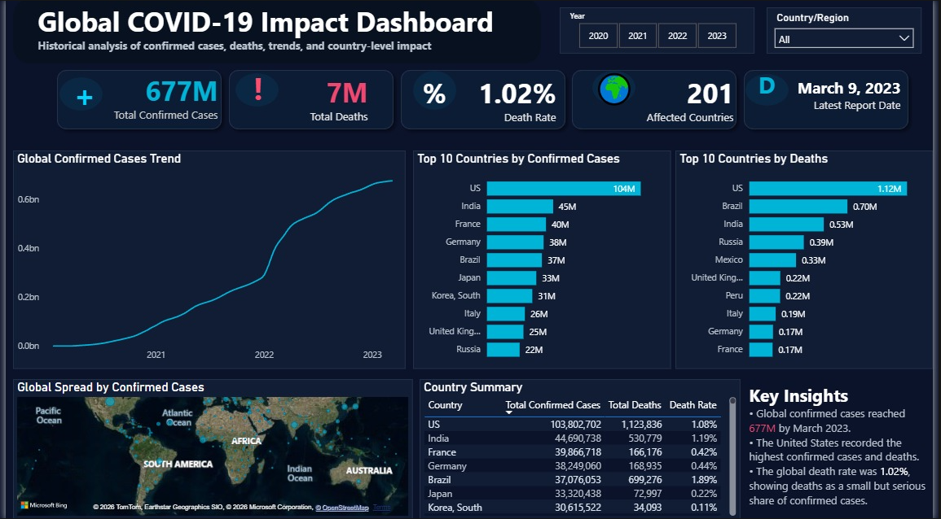

Slide 6
Data Cleaning & Transformation
Imported confirmed cases and deaths CSV files
Unpivoted date columns into rows
Merged confirmed and deaths data
Created Year and Month columns
Built KPIs using DAX measures

Slide 7
Key Insights
Global confirmed cases reached 677M by March 2023. The United States recorded the highest confirmed cases and deaths. The global death rate was 1.02%. The trend chart shows major growth around 2021–2022.

Slide 8
Challenges faced
Some of the challenges I faced were;
Reshaping the time-series data from many date columns into rows using Unpivot.
Merging confirmed cases and deaths correctly while handling blank Province/State values.
Balancing a dark dashboard design with readability and professional presentation.

Slide 9
Recommendations & Conclusion
Decision-makers should monitor early case growth trends. Countries with high death rates should receive stronger healthcare support. Dashboards help communicate public-health data clearly. This project improved my skills in Power BI, data transformation, KPI analysis, and data storytelling.

Slide 10
THANK YOU Questions?

